Slide 1
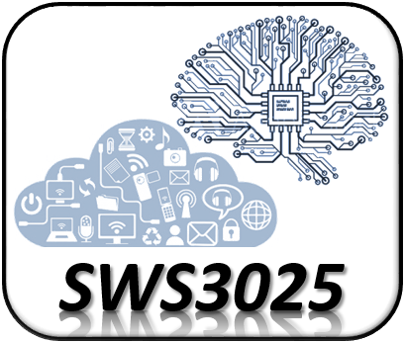
Introduction to Artificial Intelligence of Things (AIoT) Artificial Intelligence of Things (SWS3025) NUS SoC Summer Workshop 2024
Lecture 1
Lecturer: A/P TAN Wee Kek
Email: tanwk@comp.nus.edu.sg :: WeChat :: tanweekek

Slide 2

Learning Objectives
At the end of this lecture, you should understand:
What is Internet of Things (IoT).
What is IoT system and how it differs from the term IoT.
What is Artificial Intelligence of Things (AIoT).
What is Artificial Intelligence (AI).
How to implement AI with machine learning.

Slide 3
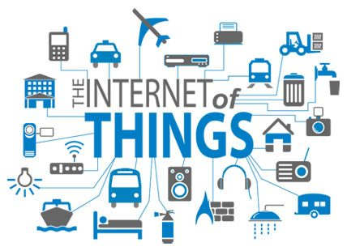
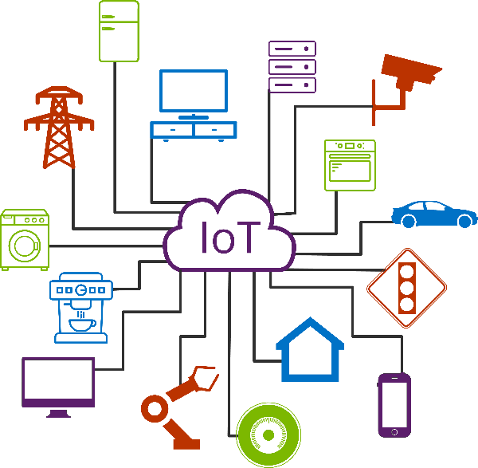
What is Internet of Things (IoT)?
Internet of Things (IoT) refers to physical devices that connect and exchange data with other devices over the Internet.
IoT devices are embedded with electronics, software, sensors, actuators and network connectivity.
IoT enables people and objects to be connected anytime, anyplace, with anyone and anything.

Slide 4


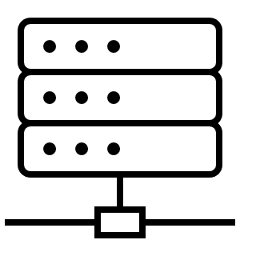
What is Internet of Things (IoT)? (cont.)
To better understand IoT, let’s breakdown the term.
Internet:
A computer network refers to a group of computers that are directly connected together for data exchange.
Internet refers to the global interconnection of computer networks for data exchange.
Computer Network
Internet

Slide 5




What is Internet of Things (IoT)? (cont.)
Things:
A thing can be anything that is not a conventional computer.
A thing may refer to any person or physical object.
A thing is a connected device or smart device.
Internet of Things

Slide 6
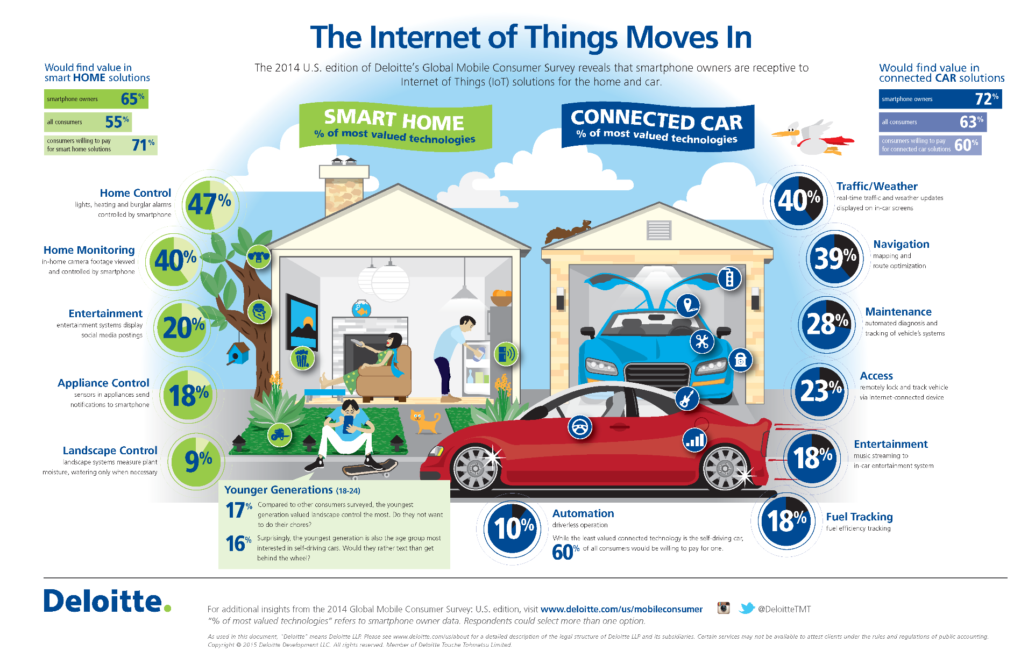
What is Internet of Things (IoT)? (cont.)

Slide 7
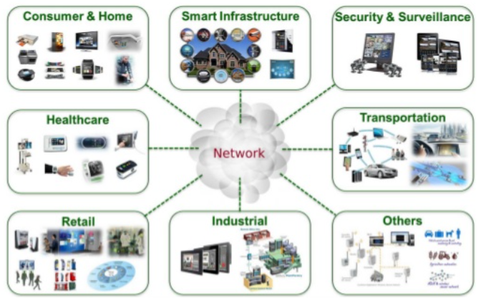
What is Internet of Things (IoT)? (cont.)
IoT has emerged as an important technology with applications in many fields:

Slide 8
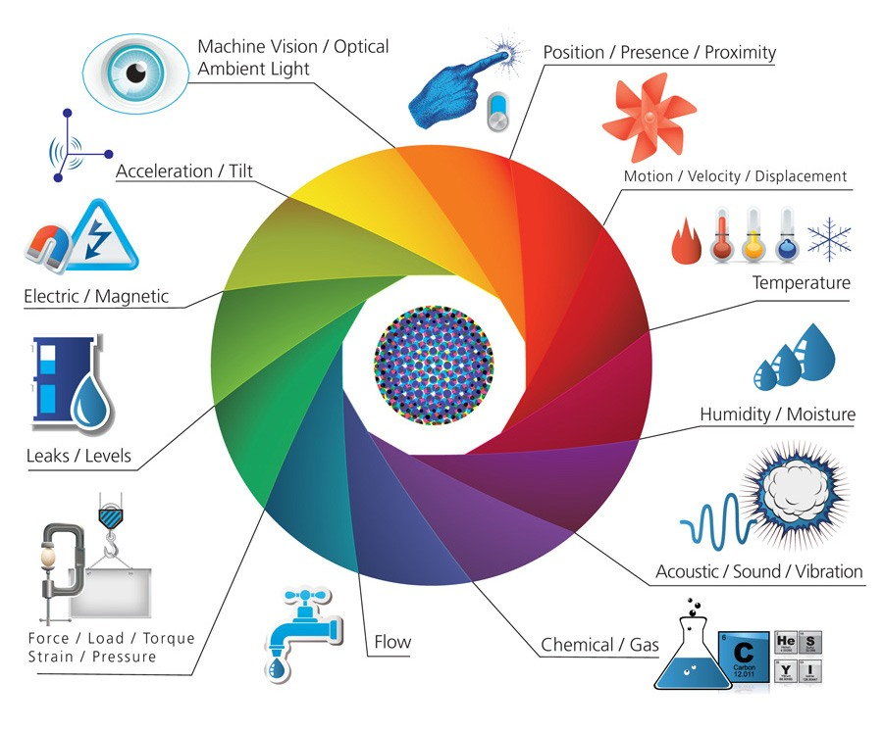
IoT for Data Collection and Beyond
Data exchanged by IoT devices are typically collected from sensors:

Slide 9
IoT for Data Collection and Beyond (cont.)
The sensor data collected are sent over the Internet to a server for storage in a database.
The stored data may be subjected to further processing.
In real-world IoT applications, the processed sensor data is used to provide information and services.
This basic IoT data collection, storage and processing architecture is known as cloud architecture.

Slide 10
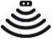
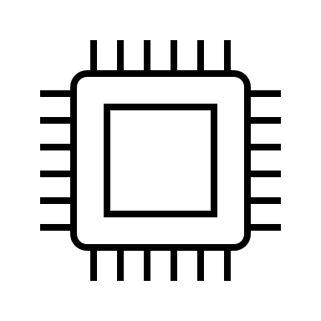



IoT for Data Collection and Beyond (cont.)
Sensors
IoT Device
Sensors
IoT Device
Internet Access Device
Server
Database
Applications providing information and services
Sensors
IoT Device
IoT Cloud Architecture

Slide 11
What is IoT System?
The term IoT system more accurately describes the use of this technology than does IoT itself:
Most IoT devices are connected together to form purpose-specific systems.
They are less frequently used as general data collection devices.
A comparison based on the foundation technologies of IoT provides a better understanding between IoT and IoT system:
Pervasive technology.
Sensor network.
Embedded computing.

Slide 12
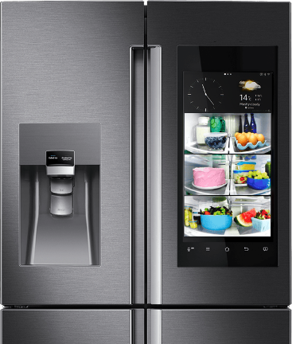
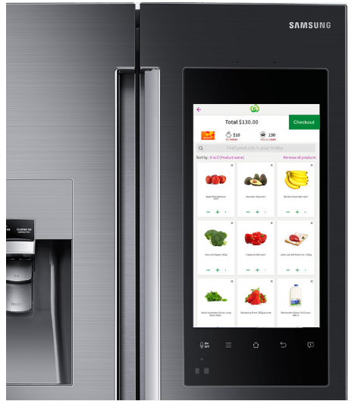
What is IoT System? (cont.)
Pervasive technology:
A smart refrigerator allows user to enter information about its contents for menu planning.
A smarter device would automatically scan the refrigerator contents to automate data entry.
But these use cases are not very different from a menu planning software on a stand-alone computer.
An IoT system emphasizes delivery of information or services such as automated groceries ordering.

Slide 13
What is IoT System? (cont.)
Sensor network:
A traditional sensor network is designed for data collection at very low data rates.
The collected data would then be sent to an external server for storage and processing.
An IoT system emphasizes in-network processing.
Embedded computing:
Traditional embedded computing focused on either stand-alone devices or tightly-coupled local networks such as those used in vehicles.
An IoT system emphasizes connected devices interacting with a wider external network, typically the Internet.

Slide 14
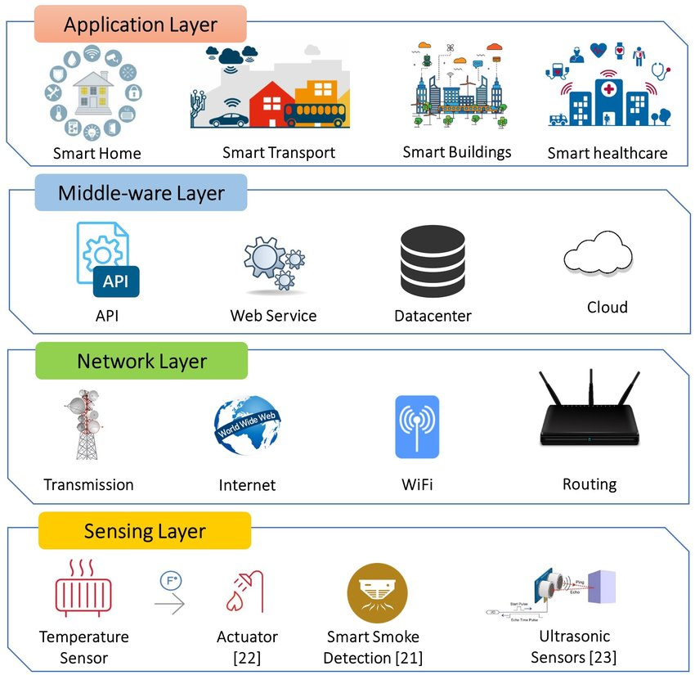
What is IoT System? (cont.)
IoT system exhibits two important characteristics:
Designed for one or more applications, rather than being a collection of IoT devices.
Sense and respond to its environment by processing the data collected.

Slide 15
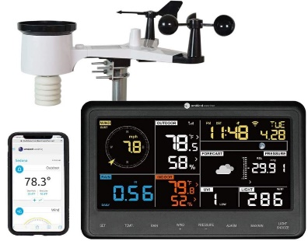
What is Artificial Intelligence of Things (AIoT)
IoT and data are intrinsically linked together:
The sensor data generated from IoT devices is of value only if it gets subjected to analysis.
Predictive analytics with Artificial Intelligence (AI) and machine learning is a critical success factor of IoT system.
Example of an IoT system incorporating predictive analytics:
A home weather station can measure temperature and humidity and detect rain.
We can build a data dashboard and a mobile app to tell us the latest weather information.
But what else can we do with this IoT system?

Slide 16
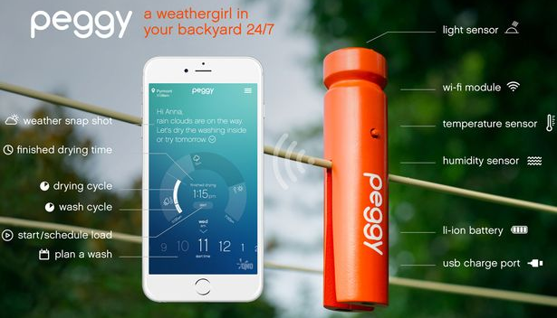
What is Artificial Intelligence of Things (AIoT) (cont.)
Can we make this IoT system smart?
If we know that it might rain soon, i.e., before it actually rains…
We want to bring in the clothesline and close the window before everything gets wet.
We can build a predictive analytics model using machine learning to forecast rain.
E.g., Temperature, Humidity → Rain
Peggy is an example of a smart clothes peg:

Slide 17

What is Artificial Intelligence of Things (AIoT) (cont.)

Slide 18
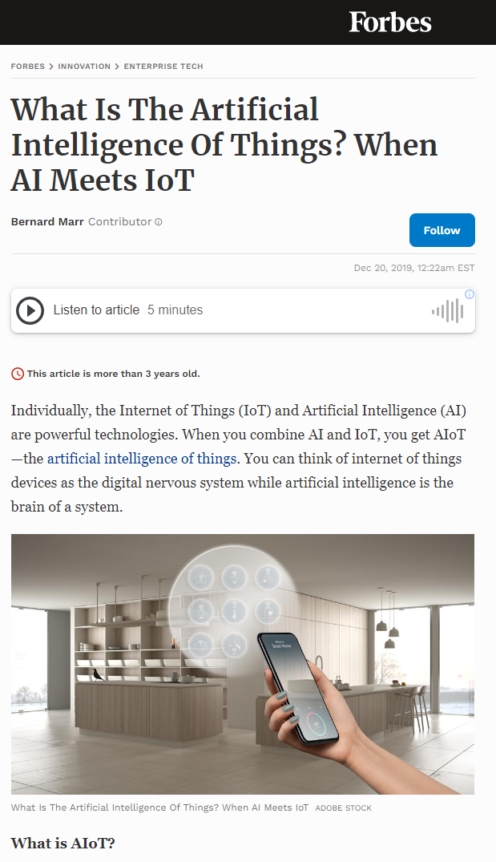
What is Artificial Intelligence of Things (AIoT) (cont.)
AIoT is the combination of Artificial Intelligence (AI) and IoT.
AIoT enables smart IoT operations that optimise human-machine interaction, data management and analytics.
Source: https://www.forbes.com/sites/bernardmarr/2019/12/20/what-is-the-artificial-intelligence-of-things-when-ai-meets-iot

Slide 19
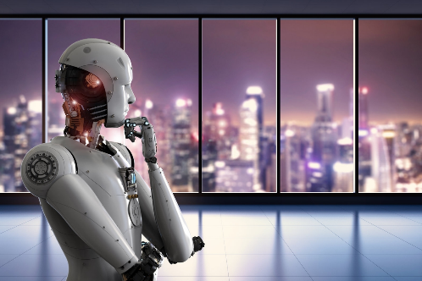
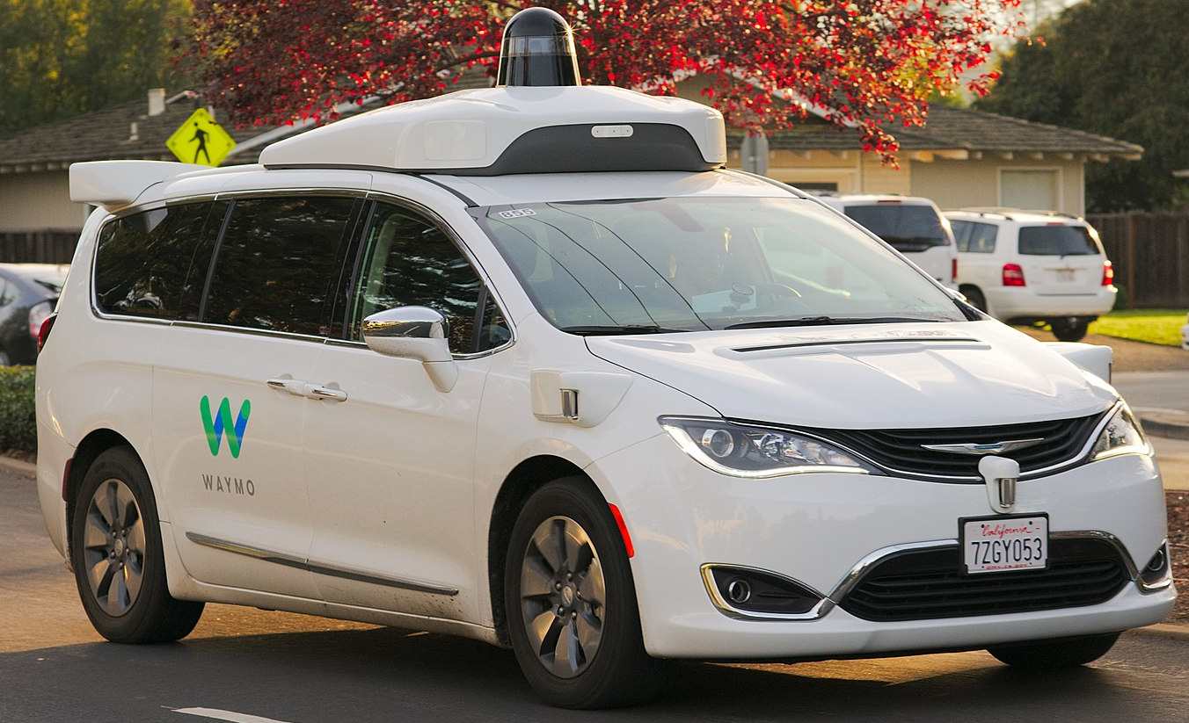
What is Artificial Intelligence (AI)?
Artificial Intelligence (AI) refers to the ability of machines to mimic cognitive functions that humans perform with the brain.
Such cognitive functions includes “learning” and “problem solving”.
An example of AI – Self-driving vehicle:
A vehicle that is capable of sensing its environment and moving safely with little or no human input.
Use computer vision to detect traffic light, pedestrians and obstacles to predict its trajectory and plan its motion.

Slide 20
What is Artificial Intelligence (AI)? (cont.)
What does AI entail?
Artificial Intelligence
AI is an umbrella term for machines capable of perception, logic and learning.
Machine Learning
Machine learning employs algorithms that learn from data to make predictions or decisions, and whose performance improves when exposed to more data over time.
Deep Learning
Deep learning uses many-layered neural networks to build algorithms that find the best way to perform tasks on their own, based on large sets of data.

Slide 21
More About Machine Learning
Machine learning employs statistical and mathematical techniques to build a model based on sample data:
The sample data are also known as “training data”.
The model is used to make predictions or decisions without being explicitly programmed to do so.
Example – Self-driving vehicle:
We don’t program a vehicle to drive in all roads and traffic scenarios.
We create a machine learning model so the vehicle can input image/video feeds into the model to predict its trajectory and motion.
Intuitively, we can think of machine learning as learning an A → B mapping:
A is the input and B is the output label.

Slide 22
More About Machine Learning (cont.)
Example – Smart home weather station:
A includes temperature and humidity.
B is a label telling us whether it would rain or would not rain.
Example – Self-driving vehicle:
A is image pixels.
B is an image label that tells us whether:
The object in front is a traffic light.
Whether the traffic light signal is green, amber or red.
Whether there is pedestrian in front of the vehicle.
Etc.

Slide 23
AIoT – The Whole is Greater than the Sum of the Parts
Machine learning can be applied to conventional data:
Data may not be captured accurately in real-time.
Self-reported data that are subjective in nature.
Such data are also prone to errors.
Example – Smart home weather station:
Ask user to measure temperature and humidity manually and input data.
Is it even feasible to ask user to monitor or detect rain?
AIoT system collect, store and process sensor data:
Data are captured automatically, accurately and correctly in real-time.
Objective data captured about environment in authentic setting.

Slide 24
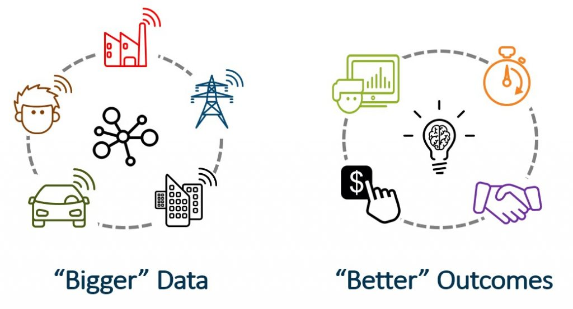
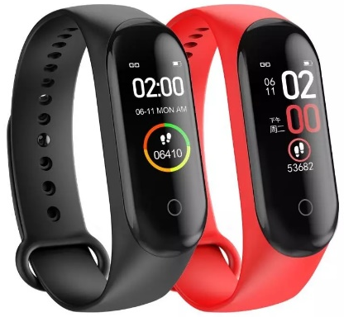
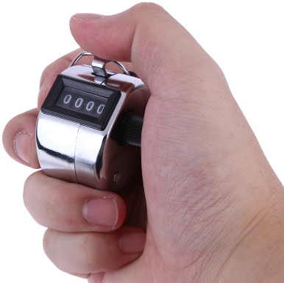
AIoT – The Whole is Greater than the Sum of the Parts (cont.)
Predictions from machine learning model trained with IoT sensor data are used to perform smart actuation.
Example – Personal fitness application:
We can use pedometer to track our running or use a hand tally counter.
Which approach provides better data to determine your fitness workout?
How about tracking heart rate while running to detect abnormal condition?

Slide 25
AIoT Case Study Walk-through
We will consider a simple example of weather forecast using IoT sensor data:
Predict whether it will rain using temperature and humidity.
Temperature, Humidity (A) → Rain (B)
If our AIoT system predicts that it will rain soon, we can close the window and perhaps bring in the clothesline before it actually rains.
We need a labelled dataset for training:
Historical dataset of temperature, humidity and rain.
Cold start problem – The system cannot draw any inferences for users about which it has not yet gathered sufficient information.

Slide 26
AIoT Case Study Walk-through (cont.)
We can use a rain/moisture sensor to detect rain in conjunction with temperature and humidity sensors.
Once we have collected enough observations in the dataset, we can train a model to predict whether it will rain.
High-level architecture of the AIoT real-time sensor data pipeline:
Sensor Node/Edge
Collect sensor values at periodic interval.
Cloud Server
Store sensor values in database.
Python Analytics Program
Use a sliding window technique to select most recent observations for training model.
Report sensor values to cloud server.
Save model
Python Analytics Web Service
Expose a web service for a software application to consume.
Pass in current temperature and humidity and gets a prediction on whether it will rain.
Python Data Prep Program
Remove observations with missing data.
Smooth out the sensor values over a predefined interval.

Slide 27
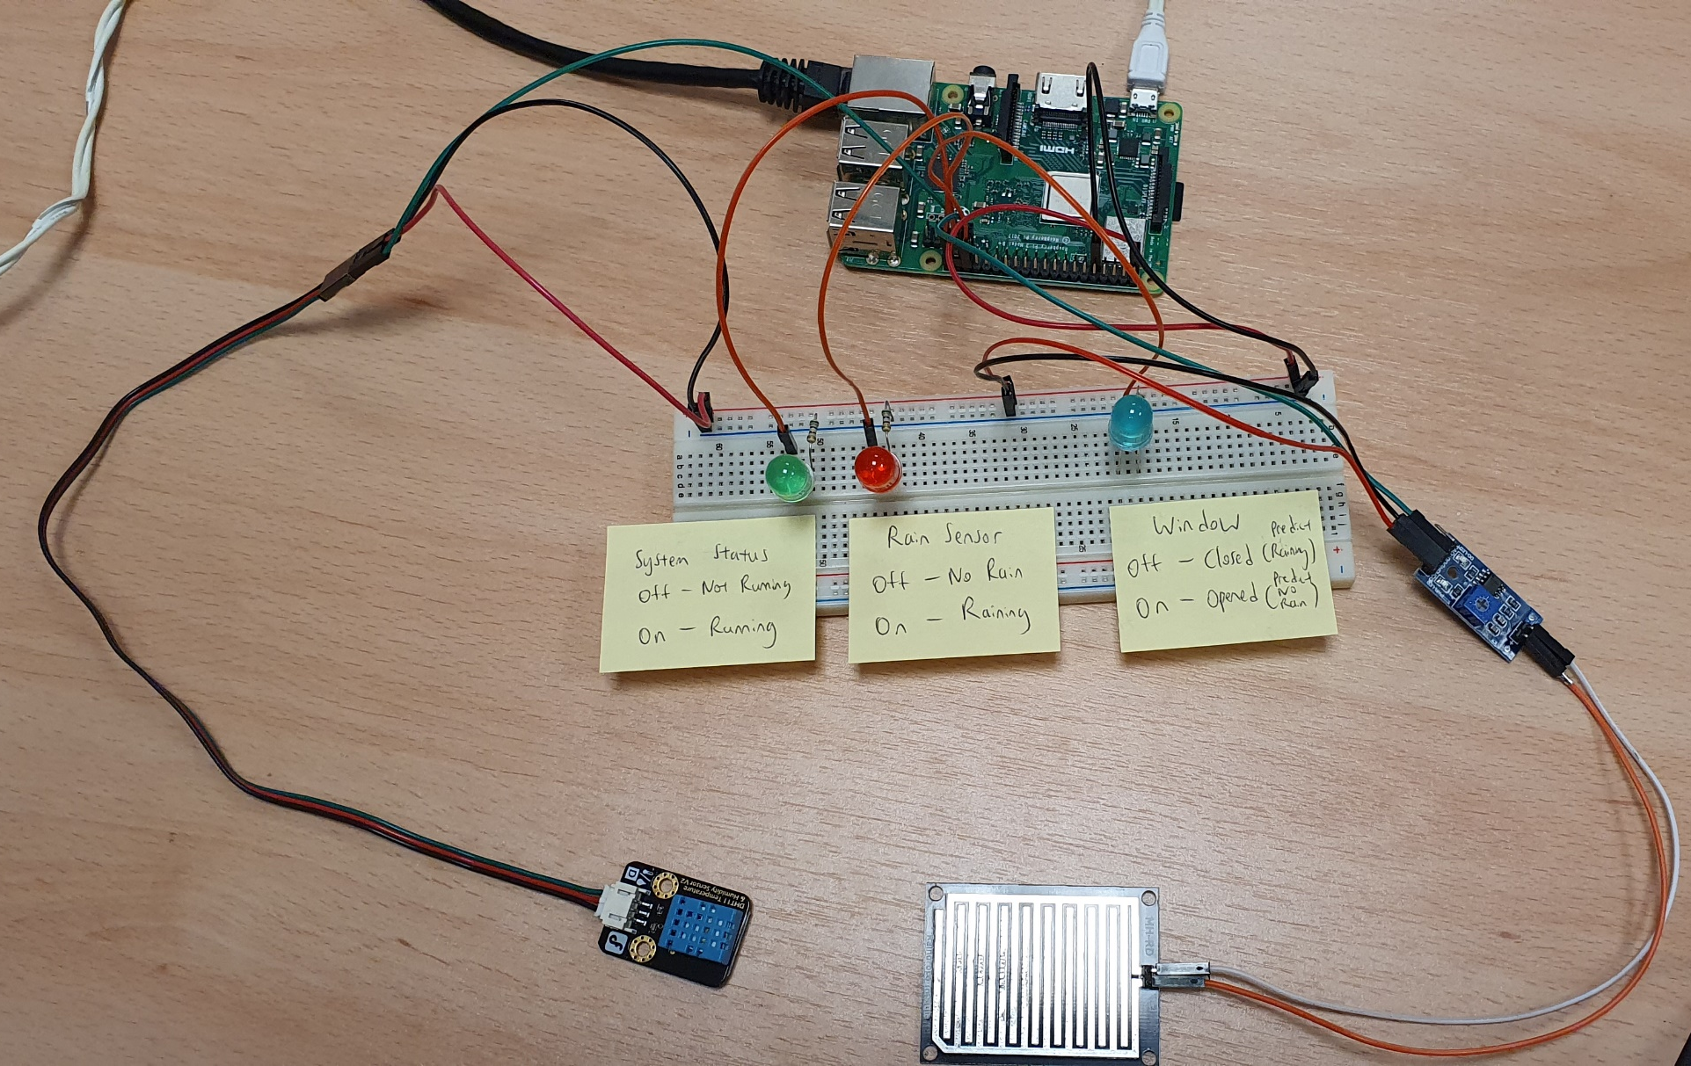
AIoT Case Study Walk-through (cont.)
Raspberry Pi 3 Model B
Breadboard
MH-RD
DHT11

Slide 28
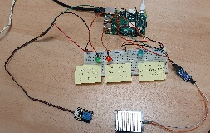
AIoT Case Study Walk-through (cont.)
Sensor
Wired Connection
RESTful Web Services
Edge Processor
Sensor
Relational Database
Pre-trained ML Model
Sensor
Call web service to upload sensor data
Cloud Server
Web Services
The top setup includes temperature, humidity and rain/moisture sensor.
In the actual demo, the nodes and hub are combined together for simplicity.
Cloud Database
Machine Learning
Sensor
Edge Processor
Call web service to predict rain
Sensor
The bottom setup includes only temperature and humidity sensor.

Slide 29
AIoT Case Study Walk-through (cont.)
Hypothetical machine learning prediction scenarios:
Simulate raining condition by applying hairdryer on DHT11 sensor and dripping water on MH-RD module.
This manipulation allows the machine learning model output, i.e., decision tree classifier, to be readily interpretable.
Sensor/Manipulation |  | Rain
 |  | No |  | Yes
DHT11 | Temperature | Moderate | ≈ 24°C | High | > 50°C
 | Humidity | Moderate | ≈ 60-70 | Low | ≈ 0
Hairdryer |  | Off |  | On
MH-RD | Rain/Moisture Sensor | Without Water |  | With Water

Slide 30

Summary
IoT refers to the interconnection of people and objects for exchanging data over the Internet.
IoT devices utilise sensors to collect data about their environment.
In an IoT system, sensor data is collected, stored and processed to provide useful information and services.
Application of AI and machine learning to sensor data is a critical success factor of IoT system.
AIoT is a combination of AI and IoT to create a smart system.

Slide 31
Summary (cont.)
AI refers to the ability of machines to mimic cognitive functions that humans perform with the brain.
Machine learning is an important branch of AI that employs statistical and mathematical algorithms to train a model with data for making predictions.
An AIoT system offers advantages as compared to the use of conventional machine learning.

